Slide 1
MAS291 Computer Project
Statistics of Car Purchase Amount of this shop Customer

Slide 2
1/ Reason
- Market Research: Descriptive statistics about how much people spend on cars is a way to research the market and better understand customer trends and tastes.
- Audience: Descriptive statistics of car purchase value also help you determine your audience. Analyze this information to devise appropriate business strategies and achieve business goals.
- Market forecast: Descriptive statistics on car purchase value also help you forecast future market conditions. You can forecast the value of cars, trends and tastes of customers to build a suitable business strategy.

Slide 3
2/ Data Collection And Analysis
Information of the group of customers who buy cars
- Link : data

Slide 4
POPULATION
Customer Name | Customer e-mail | Country | Gender | Age | Annual Salary | Credit Card Debt | Net Worth | Car Purchase Amount
Martina Avila | cubilia.Curae.Phasellus@quisaccumsanconvallis.edu | USA | 0 | 42 | 62812.09301 | 11609.38091 | 238961.2505 | 35321.45877
Harlan Barnes | eu.dolor@diam.co.uk | USA | 0 | 41 | 66646.89292 | 9572.957136 | 530973.9078 | 45115.52566
Naomi Rodriquez | vulputate.mauris.sagittis@ametconsectetueradipiscing.co.uk | USA | 1 | 43 | 53798.55112 | 11160.35506 | 638467.1773 | 42925.70921
Jade Cunningham | malesuada@dignissim.com | USA | 1 | 58 | 79370.03798 | 14426.16485 | 548599.0524 | 67422.36313
Cedric Leach | felis.ullamcorper.viverra@egetmollislectus.net | USA | 1 | 57 | 59729.1513 | 5358.712177 | 560304.0671 | 55915.46248
Carla Hester | mi@Aliquamerat.edu | USA | 1 | 57 | 68499.85162 | 14179.47244 | 428485.3604 | 56611.99784
Griffin Rivera | vehicula@at.co.uk | USA | 1 | 47 | 39814.522 | 5958.460188 | 326373.1812 | 28925.70549
Orli Casey | nunc.est.mollis@Suspendissetristiqueneque.co.uk | USA | 1 | 50 | 51752.23445 | 10985.69656 | 629312.4041 | 47434.98265
Marny Obrien | Phasellus@sedsemegestas.org | USA | 0 | 47 | 58139.2591 | 3440.823799 | 630059.0274 | 48013.6141
Rhonda Chavez | nec@nuncest.com | USA | 1 | 43 | 53457.10132 | 12884.07868 | 476643.3544 | 38189.50601
Jerome Rowe | ipsum.cursus@dui.org | USA | 1 | 50 | 73348.70745 | 8270.707359 | 612738.6171 | 59045.51309
Akeem Gibson | turpis.egestas.Fusce@purus.edu | USA | 1 | 53 | 55421.65733 | 10014.96929 | 293862.5123 | 42288.81046
Quin Smith | nulla@ipsum.edu | USA | 0 | 44 | 37336.3383 | 10218.32092 | 430907.1673 | 28700.0334
Tatum Moon | Cras.sed.leo@Seddiamlorem.ca | USA | 0 | 48 | 68304.47298 | 9466.995128 | 420322.0702 | 49258.87571
Sharon Sharpe | eget.metus@aaliquetvel.co.uk | USA | 0 | 55 | 72776.00382 | 10597.63814 | 146344.8965 | 49510.03356
Thomas Williams | aliquet.molestie@ut.org | USA | 1 | 53 | 64662.30061 | 11326.03434 | 481433.4324 | 53017.26723
Blaine Bender | ultrices.posuere.cubilia@pedenonummyut.net | USA | 0 | 45 | 63259.87837 | 11495.54999 | 370356.2223 | 41814.72067
Stephen Lindsey | erat.eget.ipsum@tinciduntpede.org | USA | 1 | 48 | 52682.06401 | 12514.52029 | 549443.5886 | 43901.71244

Slide 5
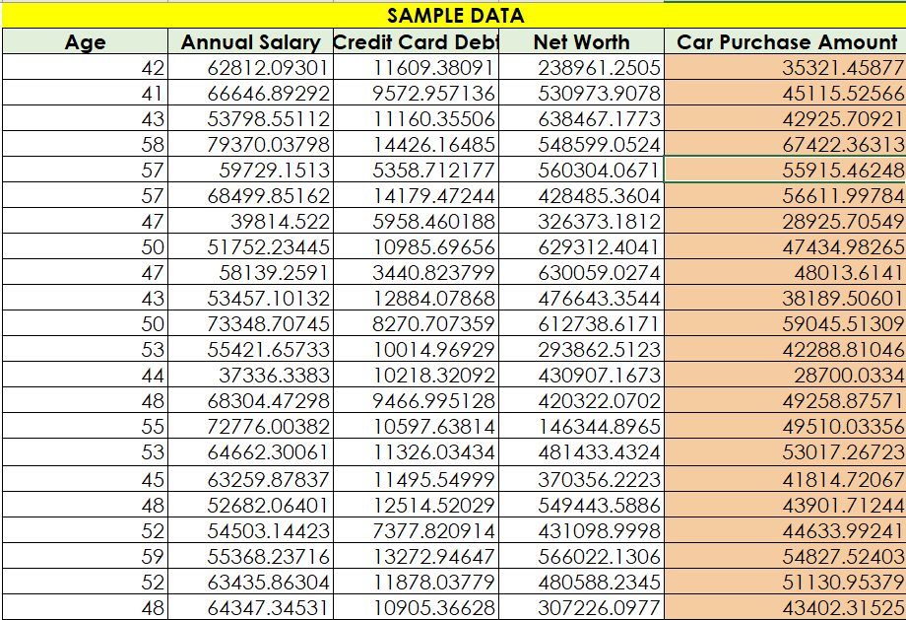

Slide 6
Age |  |  | Credit Card Debt |  |  | Car Purchase Amount
Mean | 46.224 |  | Mean | 9607.645049 |  | Mean | 44209.79922
Standard Error | 0.357338817 |  | Standard Error | 156.0412299 |  | Standard Error | 481.7912001
Median | 46 |  | Median | 9655.035568 |  | Median | 43997.78339
Mode | 43 |  | Mode | #N/A |  | Mode | #N/A
Standard Deviation | 7.990338856 |  | Standard Deviation | 3489.187973 |  | Standard Deviation | 10773.17874
Sample Variance | 63.84551503 |  | Sample Variance | 12174432.71 |  | Sample Variance | 116061380.3
Kurtosis | -0.07296831 |  | Kurtosis | 0.099148574 |  | Kurtosis | 0.227238006
Skewness | 0.008082153 |  | Skewness | -0.063724404 |  | Skewness | -0.030790505
Range | 50 |  | Range | 19900 |  | Range | 71000
Minimum | 20 |  | Minimum | 100 |  | Minimum | 9000
Maximum | 70 |  | Maximum | 20000 |  | Maximum | 80000
Sum | 23112 |  | Sum | 4803822.524 |  | Sum | 22104899.61
Count | 500 |  | Count | 500 |  | Count | 500
Confidence Level(95.0%) | 0.702074076 |  | Confidence Level(95.0%) | 306.5787905 |  | Confidence Level(95.0%) | 946.5893312
Annual Salary |  |  | Net Worth
Mean | 62127.23961 |  | Mean | 431475.7136
Standard Error | 523.3909857 |  | Standard Error | 7760.799675
Median | 62915.49704 |  | Median | 426750.1207
Mode | #N/A |  | Mode | #N/A
Standard Deviation | 11703.37823 |  | Standard Deviation | 173536.7563
Sample Variance | 136969061.9 |  | Sample Variance | 30115005801
Kurtosis | 0.096049217 |  | Kurtosis | -0.33406563
Skewness | -0.087478288 |  | Skewness | 0.139755245
Range | 80000 |  | Range | 980000
Minimum | 20000 |  | Minimum | 20000
Maximum | 100000 |  | Maximum | 1000000
Sum | 31063619.8 |  | Sum | 215737856.8
Count | 500 |  | Count | 500
Confidence Level(95.0%) | 1028.321653 |  | Confidence Level(95.0%) | 15247.87122

Slide 7
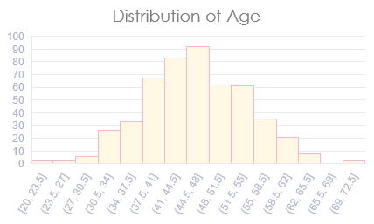
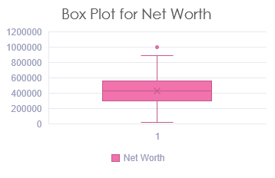

Slide 8
3/
Construct a two-sided 95% confidence interval for mean of Age, Annual Salary, Credit Card Debt, Net Worth, Car Purchase Amount for The Shop

Slide 9

We are 95% confident that the mean of age falls in the interval from 45.52192592 to 46.92607408
We are 95% confident that the mean of annual salary falls in the interval from 61098.91796 to 63155.56126
We are 95% confident that the mean of credit card falls in the interval from 9301.066258 to 9914.223839
We are 95% confident that the mean of net worth falls in the interval from 416227.8424 to 446723.5848
We are 95% confident that the mean of car purchase amount falls in the interval from 43263.20989 to 45156.38855

Slide 10
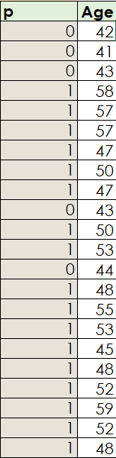
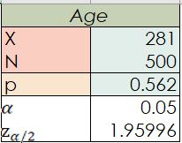
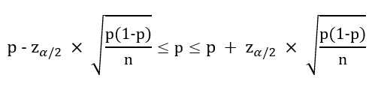
4/ Construct a two-sided 95% confidence interval for the proportion of customer Age 45+
Estimate interval for p of Age with Confidence Interval is 0.05: 0.518512 to 0.605488

Slide 11
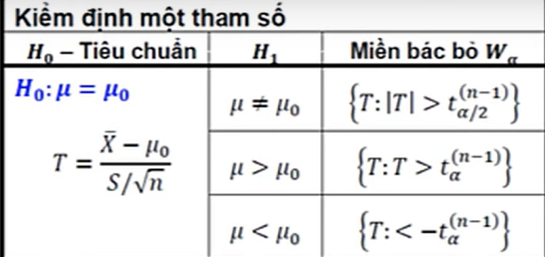
5/ TEST 1 SAMPLE u

Slide 12
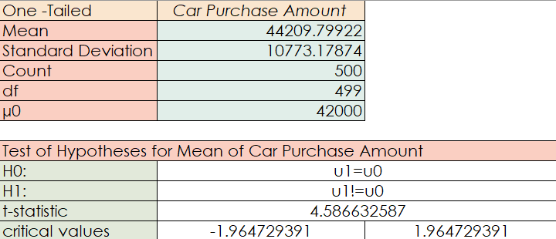
Conclusion: Reject H0
=> The average Car Purchase Amount is different from the other Shop's Car Purchase Amount

Slide 13
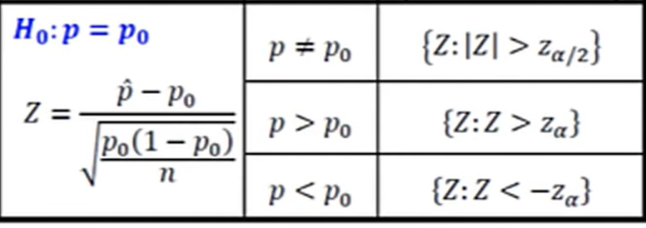
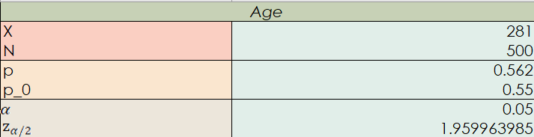
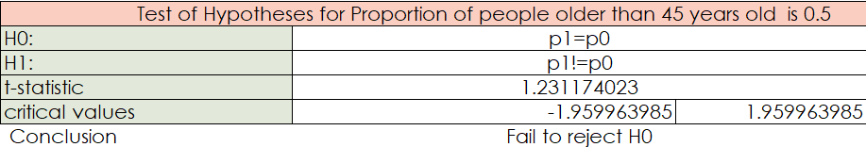
6/ TEST 1 SAMPLE P
The proportion of people older than 45 years old is not different from the other Shop’s Car Purchase Amount

Slide 14
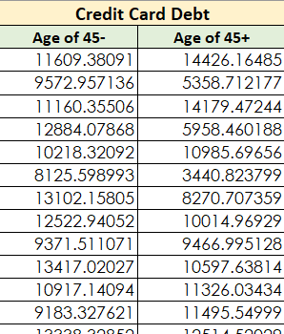
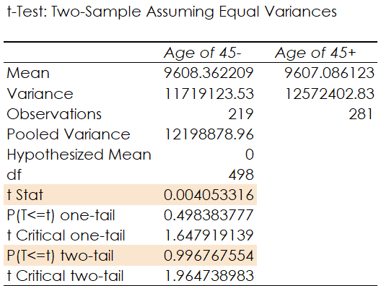
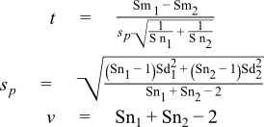
7/ TEST 2 SAMPLE TWO TAIL u
CLAIM : Does people younger than 45 years old have mean of credit card debt less than those from 45+ years old?

Slide 15
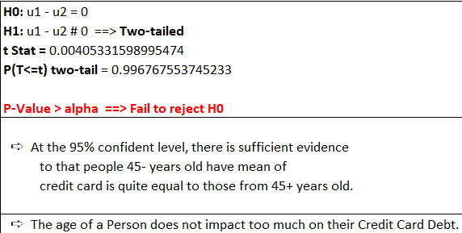
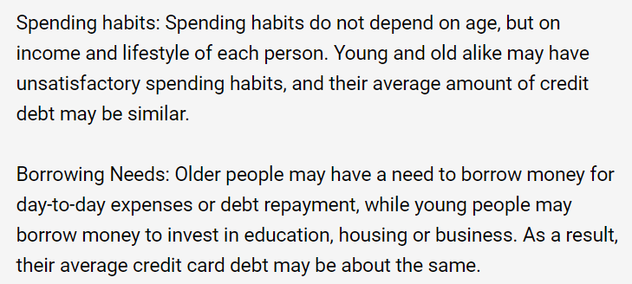

Slide 16
8/ TEST 2 SAMPLE ONE TAIL u

Slide 17
CLAIM : Does people from 45- years old have mean of net worth is larger with those from 45+ years old?

Slide 18
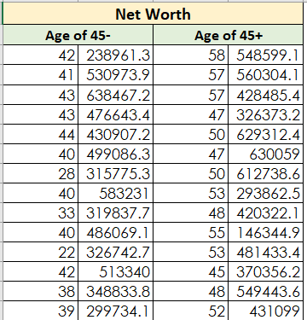
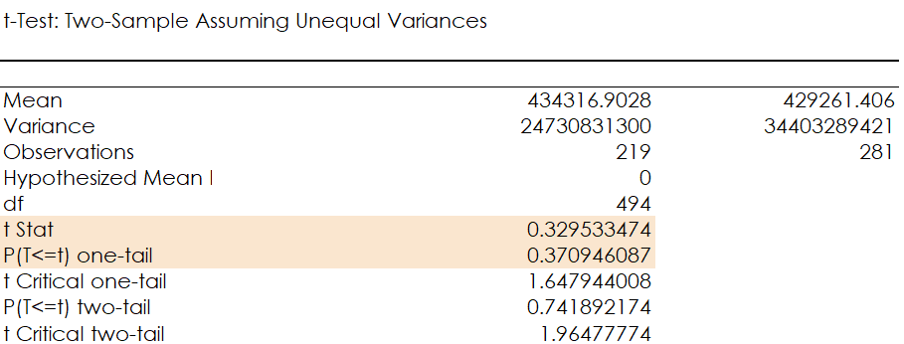

Slide 19
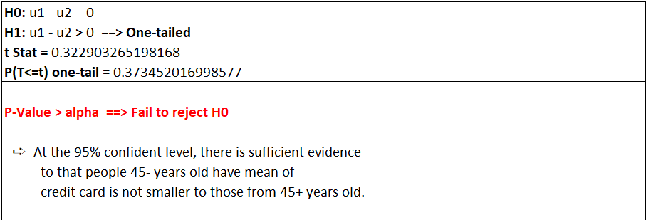

Slide 20
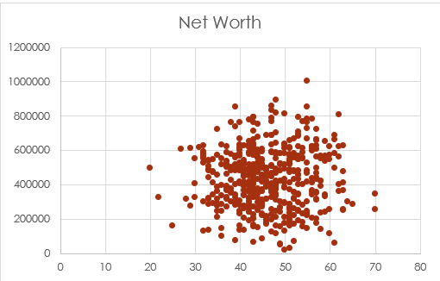
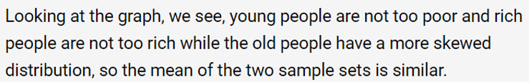

Slide 21
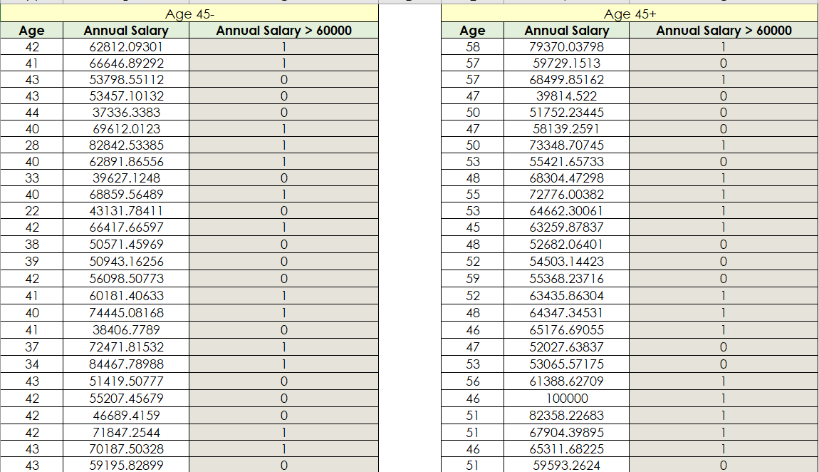
9/ TEST 2 SAMPLE P
CLAIM: Does the proportion of Annual Salary > 60000 of Customer that 45- and 45+ are similar ?

Slide 22
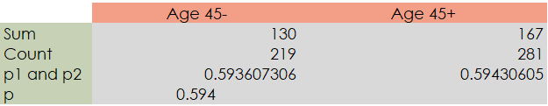
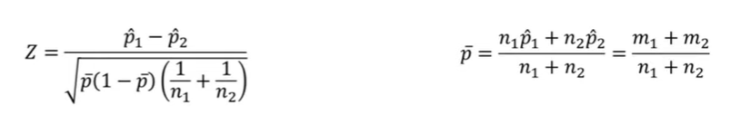
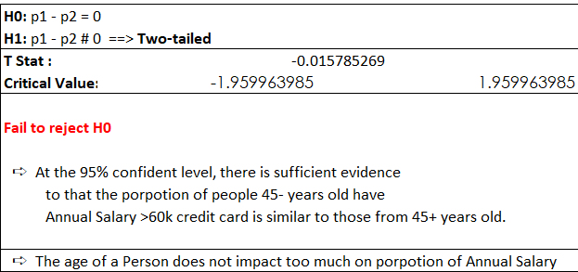

Slide 23
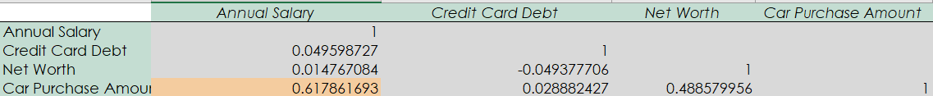
10/ LINEAR REGRESSION

Slide 24
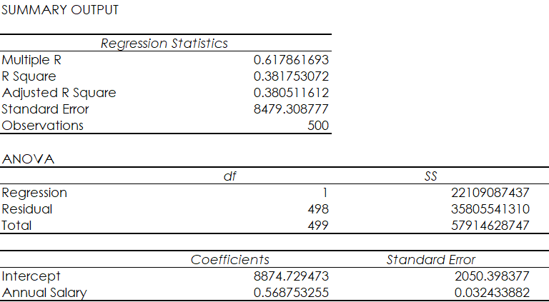

Slide 25
Conclusion:
If a customer have large Annual Salary,
they will purchase a expensive car
Annual Salary | Car Purchase Predict
50000 | 37312.39222
55000 | 40156.15849
60000 | 42999.92477
65000 | 45843.69104
70000 | 48687.45732

Slide 26


